Slide 1
Complementing Machine Learning Classifiers Via Dynamic Symbolic Execution: “Human vs. Bot Generated” Tweets
In Proc. 6th International Workshop on Realizing Artificial Intelligence Synergies in Software Engineering (RAISE’18)
Sohil L. Shrestha, Christoph Csallner
sohillal.shrestha@uta.edu, csallner@uta.edu
CSE Department, University of Texas at Arlington

Slide 2
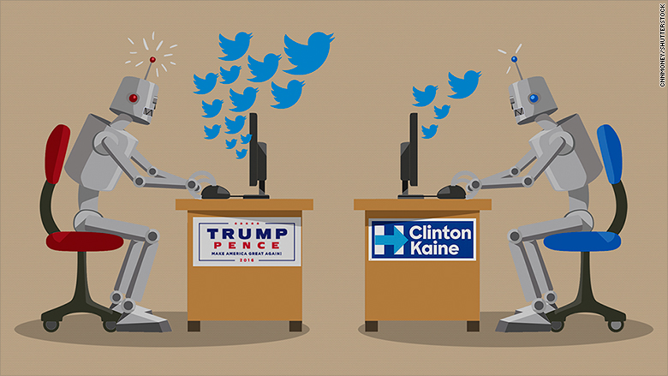
Motivation
> 300 million monthly active Twitter users
> 2 billion monthly active Facebook users
In 2016 U.S. presidential election, twitter bots that posed as humans generated many tweets to influence the outcome of the election
Sources:
http://www.reuters.com/article/twitter-results/twitter-reports-6-pct-increase-in-monthly- active-users-idUSL4N1HY48L
http://www.techcrunch.com/2017/06/27/facebook-2-billion-users/ [Accessed Feb. 2018]
http://rebrn.com/re/a-third-of-pro-trump-tweets-are-generated-by-bots-2913586/

Slide 3



Classifying Tweets: Human Vs. Bot
1. Collect Twitter Data
2. Label data
3. Train ML classifier
4. Classify using trained model
Notes:
Infer from the Source Program

Slide 4
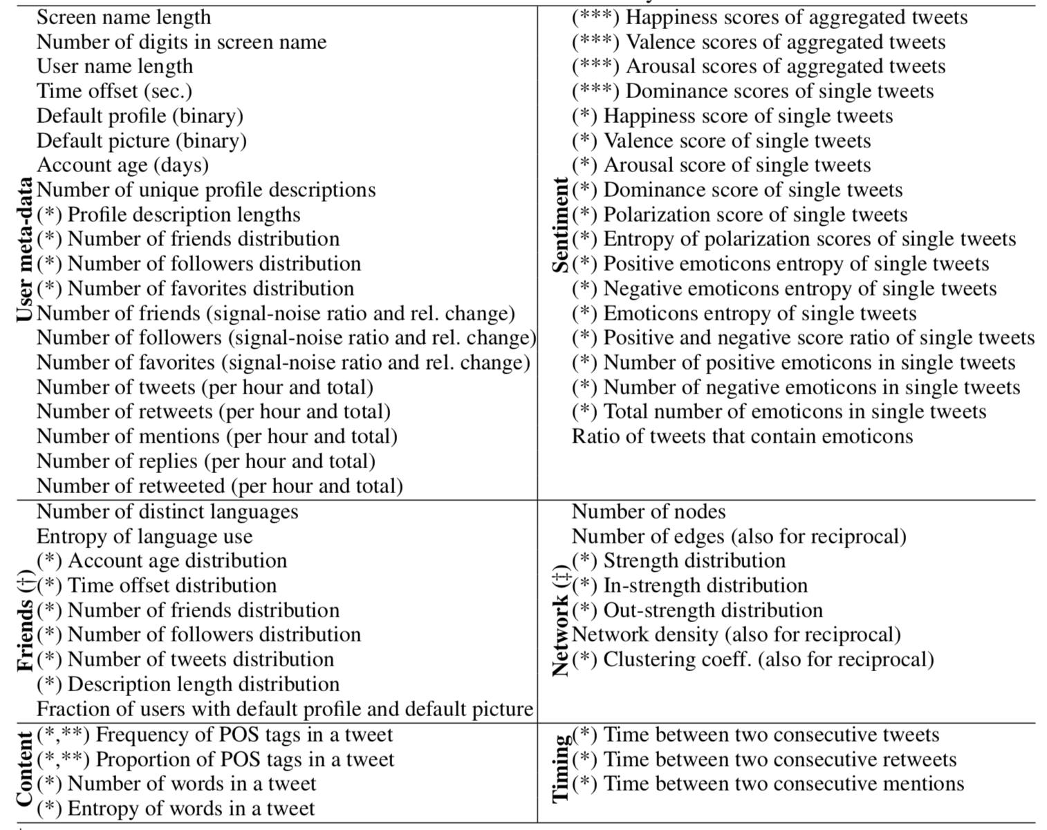
Features Fed to Classifier
Sources:
Onur Varol, Emilio Ferrara, Clayton A. Davis, Filippo Menczer, and Alessandro Flammini. 2017. Online Human-Bot Interactions: Detection, Estimation, and Characterization. In Proc. 11th Intl. Conference on Web and Social Media (ICWSM). AAAI, 280–289.

Slide 5
Conceptually : Program Analysis
Automatically analyze the program to get its behavior.
Advantage:
Better classifier
Labelling cost reduced
Can post every X minutes
Can retweet post that contains #Election
public void keyPressed(KeyEvente){
if(e.getKeyCode()==KeyEvent.VK_ENTER){
input.setEditable(false);
String quote=input.getText();
input.setText("");
addText("-->You:\t"+quote);
while(quote.charAt(quote.length()-1)=='!’ ){
}
Can Follow celebrities with X followers
Can Tweet poems
Can reply FAQs from database
Can Tweet at specific time
Notes:
Symbolic Execution
Dynamic Symbolic Execution
Pex Tool

Slide 6
Features Fed to Classifier
Source:
Onur Varol, Emilio Ferrara, Clayton A. Davis, Filippo Menczer, and Alessandro Flammini. 2017. Online Human-Bot Interactions: Detection, Estimation, and Characterization. In Proc. 11th Intl. Conference on Web and Social Media (ICWSM). AAAI, 280–289.

Slide 7
Research Direction
Machine Learning
Classical approach
Program Analysis
Research Direction
Yuriy Brun and Michael D. Ernst. 2004. Finding Latent Code Errors via Machine Learning over Program Executions. In Proc. 26th ICSE. IEEE Computer Society, 480–490.
Xin Li and others. 2016. Symbolic Execution of Complex Program Driven by Machine Learning Based Constraint Solving. In Proc. 31st IEEE/ACM Intl. Conference on Automated Software Engineering (ASE). ACM, 554–559.
Notes:
Binary Classification problem

Slide 8
Supervised Machine Learning
Potential Problems:
Expensive manual labelling
Small or incomplete training set
Feature vectors
Sample tweets
(Human +Bot)
Machine Learning Algorithm
Labels
Human
Feature vector
Predictive Model
New tweet
Bot

Slide 9
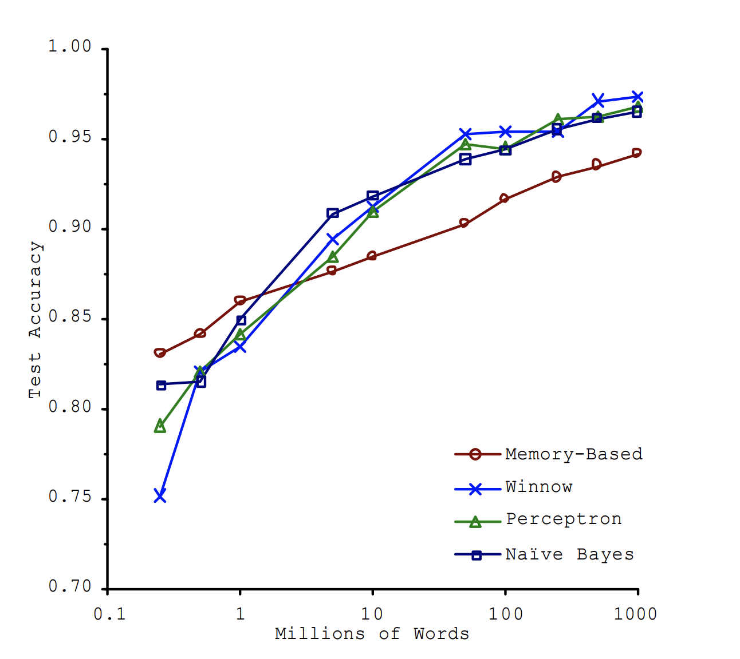
How Training Data Size Influences Machine Learning Performance
Training data size requirement depends on:
Complexity of the problem
Complexity of the learning algorithm
More Training Data = Always Better
“We don’t have better algorithms than anyone else; we just have more data”,
Google’s Chief Scientist Peter Norvig
Sources:
Banko, Michele, and Eric Brill. "Scaling to very very large corpora for natural language disambiguation." Proceedings of the 39th annual meeting on association for computational linguistics. Association for Computational Linguistics, 2001.
https://www.forbes.com/sites/scottcleland/2011/10/03/googles-infringenovation-secrets/#7ea675ea30a6

Slide 10
Human Bot Classification Problem
Known Items
Unknown Items

Slide 11
Evaluation Approach
Fix an initial training data (includes program output) T1
Use ML tool to build a classifier from T1 → Classifier C1
Run test case generator to supplement the training set → (enlarged) training data T2 := T1 + DSE_provided
Re-run ML tool on T2 to get new classifier → Classifier C2
Create a hand-written test suite T3
Compare both classifiers C1 and C2 on T3
Labels
ML algorithm
Classifier C1
Feature extractor
Features
Training Data T1
Training Data T2
Classifier C2
Test Data
T3
Training Supplement
Program
DSE
Supplement Data
Notes:
Naïve Bayes

Slide 12
Bot Program
Initial Training data (T1)
public String foo(int p)
{
if (p > 0) {
return “a”+” ”+p; //Path1
}
else{
return “b” +” ”+ (−p); // Path2
}
}
a boy,
not ok,
girl rules,
in 1921,
a 2000,
a 132
…
Test data (T3)
a girl,
a 132,
a 1821,
b 12,
b 359
…

Slide 13
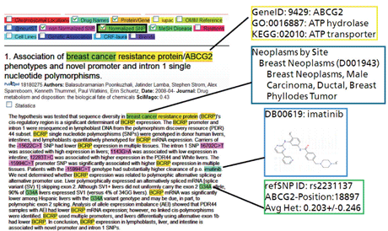
Text Classification
Training set
Unstructured text
Preprocessing
Tokenization
Stop word elimination
Stemming
Stop words like “a, the”
Stemming:
e.g., going to go
Feature extraction
(using tf-idf)
Construct Classification Model
Common words = Low TF-IDF
Train Classifier
Evaluate Classifier
Image Source:
Ebeling, Christian, et al. “Cross-Project Uptake of Biomedical Text Mining Results for Candidate Gene Searches.” ERCIM News, 9 July 2010, ercim-news.ercim.eu/content/view/547/776/.
Notes:
Naïve bayes:
Works better in limited data
Good dependable Baseline for text classification
Robust to irrelevant features

Slide 14
Choice: Naïve Bayes Classifier
Simple classification method based on bayes rule
Very fast, low storage requirements
Robust to irrelevant features
Irrelevant features cancel each other without affecting results
A good dependable baseline for text classification
Naïve Bayes is a “high-bias” algorithm
works well with small training data size
Sources:
Forman, G., & Cohen, I. (2004, September). Learning from little: Comparison of classifiers given little training. In European Conference on Principles of Data Mining and Knowledge Discovery (pp. 161-172). Springer, Berlin, Heidelberg.
https://web.stanford.edu/class/cs124/lec/naivebayes.pdf

Slide 15
Experimental Setup (Proof of Concept)
Goal:
Assess the performance of a classifier trained on DSE enriched training data
Assumptions:
Access to the program that generates the text
Only one bot program
Notes:
Text Classifcation Problem

Slide 16
Dynamic Symbolic Execution
Initially choose arbitrary input values
Solve
Run and monitor
Input
values
Constraint Solver
Execution path
Known paths
Choose an uncovered path
Record path condition
Hybrid approach
High code coverage
Image Source: https://pexforfun.com/Documentation.aspx
Notes:
Chooses a branch that was not covered previously.
Builds a constraint system that describes how to reach that branch.
Uses a constraint solver to determine new input values that fulfill the constraints,

Slide 17
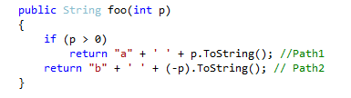
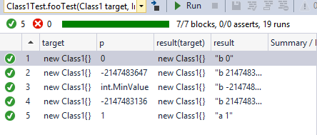
Example DSE Tool: Pex
Dynamic Symbolic Tool developed by Microsoft Research
Used for automated test case generation of .Net programs
Ships in Visual Studio 2015 Enterprise Edition

Slide 18
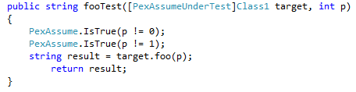
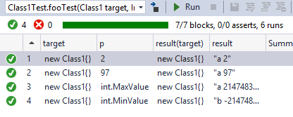
Challenge: Adapting to Pex

Slide 19


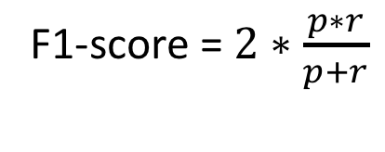
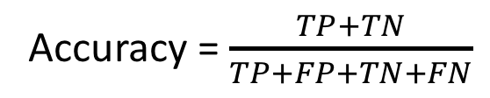
RQ: Can we use DSE inferred training samples to strengthen the Machine Learning Classifier?
Evaluation (Standard Metrics)
Precision(p) = $\frac{TP}{TP+FP}$
Accuracy = $\frac{TP+TN}{TP+FP+TN+FN}$
Recall(r) = $\frac{TP}{TP+FN}$
F1-score = $2∗\frac{p∗r}{p+r}$
TP: True Positive
FP: False Positive
TN: True Negative
FN: False Negative
Positive Class: Bot
Negative Class: Human
Notes:
F1

Slide 20
Results
Actual | C1-predicted |  | C2-predicted
 | Bot | Human | Bot | Human
Bot | TP=375 | FN=375 | 750 | 0
Human | FP=22 | TN-728 | 34 | 716
Classifier | Accuracy | Precision | Recall | F1 Score
C1 | 74.0 | 95.0 | 50.0 | 65.0
C2 | 98.0 | 96.0 | 100 | 98.0
Observation:
Complete training samples improves accuracy
DSE potential to improve suboptimal classifier
Trained On
C1: Initially fixed data
C2: DSE inferred data

Slide 21
Initial Experience: Sentence generator
Random rand = new Random();
string[] pos = {"able", "adorable", /*...*/};
string[] neg = {"aloof", "ambiguity”, /*...*/};
string[] nW = {"I", "welcome", "you”, /*...*/ };
public string createText(int numWords, int type) {
string outText = "";
string rW = nW[rand.Next(0, nW.Length)];
for (int i=0; i<numWords; i++) {
outText += rW + " ";
if (type == 1)
rW = pos[rand.Next(0, pos.Length)];
else if (type == 0)
rW = neg[rand.Next(0, neg.Length)];
else if (rand.Next(1,50000)%3==1)
rW = pos[rand.Next(0, pos.Length)];
else if (rand.Next(1, 50000) % 3 == 1)
rW=neg[rand.Next(0, neg.Length)];
else
rW = [rand.Next(0, nW.Length)];
}
return outText;
}

Slide 22
Experiment and Results
Labels
ML algorithm
Classifier C3
Feature extractor
Features
Training Data T1
Training Data T2
Classifier C4
Test Data
T3
Training Supplement
Program
DSE
Supplement Data
Classifier | Accuracy | Precision | Recall | F1 Score
C3 | 96.5 | 100 | 93.1 | 96.4
C4 | 99.4 | 100 | 98.8 | 99.4
Interesting Observation
DSE has potential to further strengthen an already accurate classifier

Slide 23
Future Work
Support a more realistic setting as depicted in human bot classification problem
Current preliminary experiment is severely limited.
Dynamic Symbolic Execution replaced by some other test case generator
Random/ Search based test case generator
Machine Learning Class imbalance problem (Overfitting problem)
Yet to be analyzed

Slide 24
Conclusions
Gap: Low-Quality Machine Learning classifier
caused by small or incomplete training sets
Currently: Machine learning approach ignore program as a source of information.
New Research Direction:
Program Analysis ->Machine Learning
Preliminary evaluation suggests potential of DSE-enriched training set to improve the classifier.

Slide 25
Thank You
University of Texas at Arlington
USA
Sohil Lal Shrestha
sohillal.shrestha@uta.edu
Twitter:@sohilnewa

